Slide 1
Neural Substrates of Attention and Awareness
Dan Birman
Gardner Lab
Kalanit Lab Meeting – 2015-02-06
Notes:
Okay! I’m interested in attention/awareness, but these are often ill-defined. I’m going to use an example to get the ideas across.

Slide 2


Notes:
Show animation, then go back and repeat: asking to attend to background (21 total black dots move, 22 with the first)
Point here is that you have no AWARENESS of the changes in the first attempt, while you’re attending to the dots. But you need very little additional attention to notice them. No bottom-up attention = inattentional blindness

Slide 4
Notes:
Now it’s obvious

Slide 5
Attention as a Pre-Requisite to Awareness
Dual task designs “pull” attention to one task, causing inattentional blindness for other stimuli.
“we believe […] there is no conscious perception without attention” (Mack & Rock, 1998)
“The close relationship between attention and
consciousness has led many scholars to conflate these
processes“ (Koch & Tsuchiya, 2006)

Slide 6
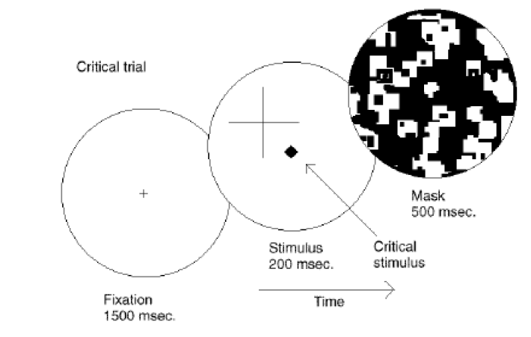
Attention as a Pre-Requisite to Awareness
Dual task designs “pull” attention to one task, causing inattentional blindness for other stimuli.
“we believe […] there is no conscious perception without attention” (Mack & Rock, 1998)
Mack & Rock, 1998
Notes:
There is one situation where attention (seems) to not be a pre-requisite for awareness

Slide 7
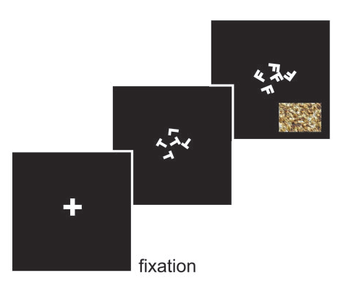
Gist Perception
“The close relationship between attention and
consciousness has led many scholars to conflate these processes“ (Koch & Tsuchiya, 2006)
Li et al., 2002
Reddy et al., 2004

Slide 8

Gist Perception
Li et al., 2002
Reddy et al., 2004

Slide 9
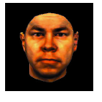
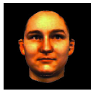
Gist Perception
Li et al., 2002
Reddy et al., 2004

Slide 10
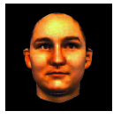
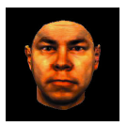
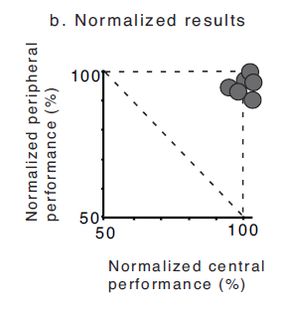
Gist Perception
Li et al., 2002
Reddy et al., 2004
Notes:
Note: dual task performance NORMALIZED by single task performance

Slide 11
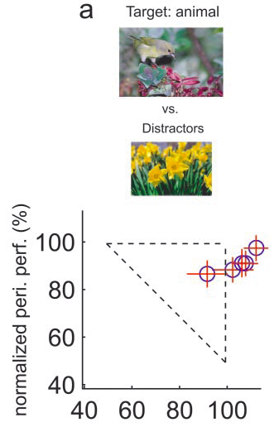
Gist Perception
Li et al., 2002
Reddy et al., 2004

Slide 12
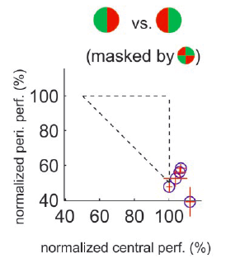
Gist Perception
Li et al., 2002
Reddy et al., 2004
Notes:
Note the whole story… what if the central task was not difficult enough? Or maybe it didn’t “interfere” with the other task?

Slide 13
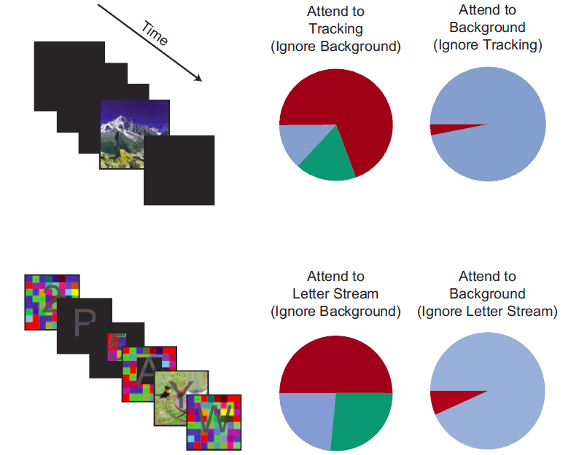
Gist Perception: Impossible Under Load?
Blind
Classified
Saw
Cohen et al., 2011
Notes:
Some tasks DO interfere enough to inhibit awareness. No awareness without attention. So is attention the precursor to awareness?

Slide 14
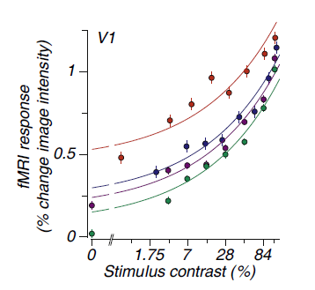
Takeaway
The current solution in psychology is to operationalize attention: defining attention in terms of it’s (measurable) effects.
An alternative solution (used in monkey neurophysiology and fMRI) is to define these concepts in terms of functional definitions.

Slide 15


http://www.globeimages.net/data/media/180/berlin_cathedral_front.jpg

Slide 16
Identifying Neural Substrates
BOLD Magnitude
Pestilli et al., 2011

Slide 17
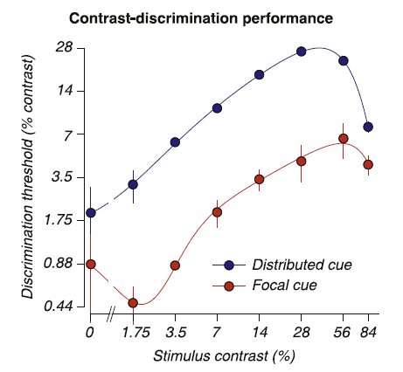
Identifying Neural Substrates
BOLD Magnitude
Pestilli et al., 2011

Slide 18
Identifying Neural Substrates
Behavioral Performance ←→ BOLD Magnitude
Pestilli et al., 2011

Slide 19
Conceptual Overview: Attention & Awareness
“Recent research has slowly corroded a belief that selective attention and consciousness are so tightly entangled that they cannot be individually examined.” (van Boxtel et al. 2010)
Attention: Local feature-specific modulation of neural activity
Awareness: A downstream process, dependent in an uncertain manner on attention.
If attention and awareness are dissociable, their models should implement different computations.
Notes:
First attempt: dual

Slide 20
Conceptual Overview: Task Design
Where are the representations for different properties of stimuli held in the brain?
Notes:
First attempt: dual

Slide 21
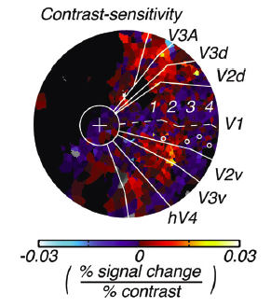
Conceptual Overview: Task Design
Where are the representations for different properties of stimuli held in the brain?
Hara et al., 2014
Tjan et al., 2006
Notes:
First attempt: dual

Slide 22
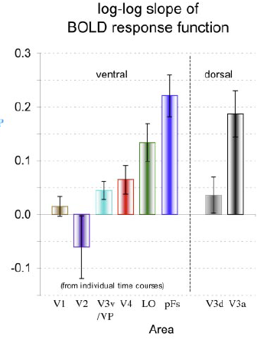
Conceptual Overview: Task Design
Where are the representations for different properties of stimuli held in the brain?
to objects
in noise
Hara et al., 2014
Tjan et al., 2006
Notes:
First attempt: dual

Slide 23
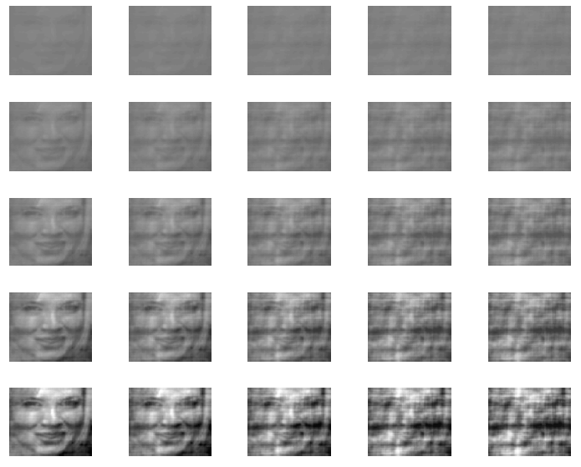
Contrast
Noise

Slide 24


Conceptual Overview: Task Design
Where are the representations for different properties of stimuli held in the brain?
What are the neural effects of pushing attention to a specific location or feature?
Notes:
First attempt: dual

Slide 25

Conceptual Overview: Task Design
Where are the representations for different properties of stimuli held in the brain?
What are the neural effects of pushing attention to a specific location or feature?
Notes:
First attempt: dual

Slide 26
(2) Selective vs. Spatial Attention
Noise Block
Contrast Block
Feature Attention: Attend to either changes in noise or changes in contrast

Slide 27
(2) Selective vs. Spatial Attention
Noise Block
Contrast Block
Spatial Attention
Focal Spatial Cue
Distributed Spatial Cue

Slide 28




(2) Selective vs. Spatial Attention
1 Block = 72 trials, ~6.4s per trial
Noise Block
Contrast Block
Fixation ITI
Cue
Stimulus
Response

Slide 29
Conceptual Overview: Task Design
Where are the representations for different properties of stimuli held in the brain?
What are the neural effects of pushing attention to a specific location or feature?
How can we measure awareness while manipulating attention?
Notes:
First attempt: dual

Slide 30


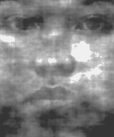

(3) Measuring Un-Attended Awareness

Slide 31

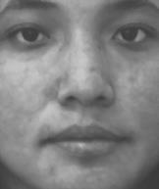
(3) Measuring Un-Attended Awareness

Slide 32
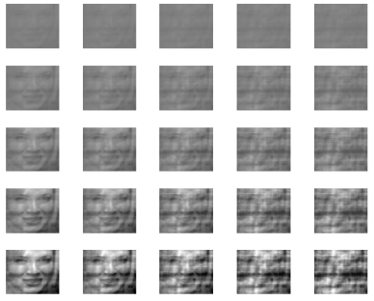
Conceptual Overview: Task Design
What the properties of stimuli represented in different brain areas?
What are the effects of pushing attention to a specific location or feature?
How can we measure awareness while manipulating attention?
Notes:
First attempt: dual

Slide 33




Overall Task Timing
Fixation ITI: 1s
1 Block = 72 trials, ~6s per trial
Cue: 1s
Stimulus 1: .6s
Peripheral Response: .8s
Stimulus 2: .6s
Per Response: .8s
Main Response: 1.2s

Slide 34

Notes:
High (dual) vs. Low (single) task conditions. Expectation: During dual task contrast/gender will have better performance than noise/gender, because noise attention is more feature-based than contrast which is more spatial.

Slide 35
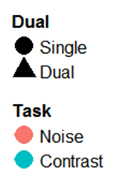
Conceptual Overview: Expectations
100%
Awareness Task Performance
Attention Task Performance
100%
Notes:
First attempt: dual

Slide 36
Conceptual Overview: Expectations
100%
Awareness Task Performance
Attention Task Performance
100%
Notes:
First attempt: dual

Slide 37
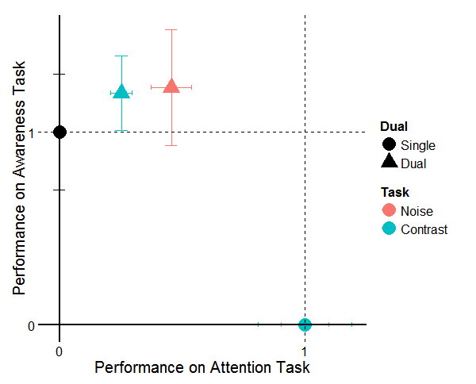
Conceptual Overview: Expectations
Notes:
First attempt: dual

Slide 38
Conceptual Overview: Expectations
Notes:
First attempt: dual

Slide 39
Attention * Awareness
There was an interaction between feature attention and awareness—but in an unexpected direction.
Is awareness of gender really a matter of “awareness”? Evidence that reading, arithmetic, priming, etc…, can be done “blind” to some extent.
Strong bottom-up attentional effects. Attention is “drawn” towards the peripheral faces.
Timing is an issue: Relative response positions cause one task to be prioritized.
Dual tasks are hard. Long training required.
Naccache et al. 2002; Sklar et al. 2012

Slide 40





(1) Specific Measures of Awareness

Slide 41
(1/2) Change Blindness: Less Bottom-Up Salience

Slide 42

(3) Timing is an issue…
Instead of a dual task, a single task with similar features.
ITI + Cue
Stimulus (change/no change)
Variable ISI
Response

Slide 43
Future Task Design
What the properties of stimuli represented in different brain areas?
What are the effects of pushing attention to a specific location or feature?
How can we measure awareness while manipulating attention?
Notes:
First attempt: dual

Slide 44





Future Task Design
Is awareness of gender really a matter of “awareness”? / Strong bottom-up attentional effects.
Timing is an issue: Relative response positions cause one task to be prioritized.
Dual tasks are hard. Long training required.

Slide 45



Gardner Lab @ Stanford University
Steeve Laquitaine
Justin Gardner
Thanks for your attention and awareness!

Slide 46
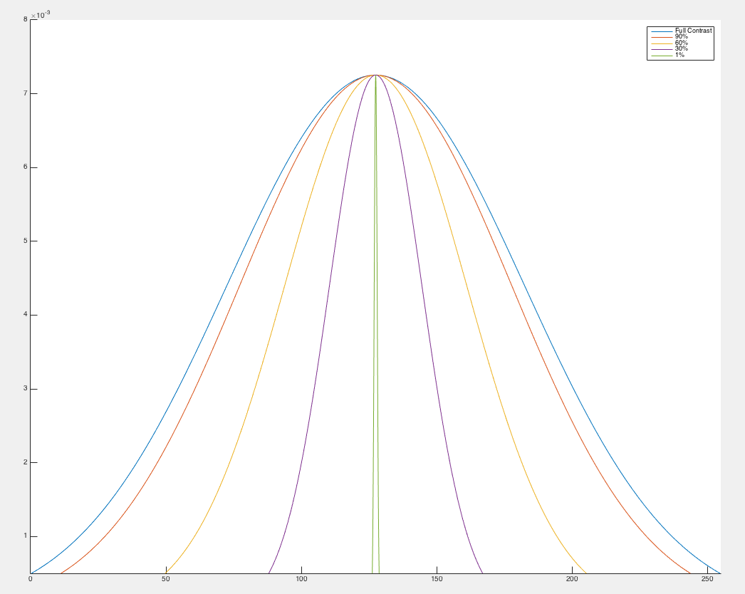
Manipulating Contrast

Slide 47
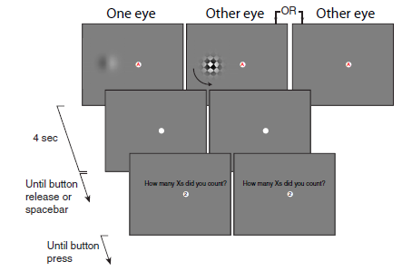
Attempts to Dis-Entangle Attention/Awareness
Dual Task Designs where attention is crossed with awareness. How does a dependent measure, e.g. afterimage length, depend on these factors?
van Boxtel et al., 2010
Notes:
Maybe attention is a pre-cursor to awareness. How might we show that? One idea is to dissociate attention and awareness.
Note: awareness manipulated with a mask or no mask, attention manipulated using secondary task

Slide 48
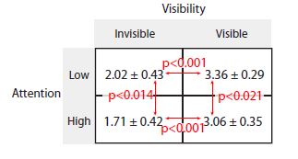
Attempts to Dis-Entangle Attention/Awareness
Afterimage Length (s)
van Boxtel et al., 2010
Notes:
Note that there is no bottom-up confound for visibility, since the expected effect is in the wrong direction
Other problems: do we really understand how binocular suppression works? Does it act at the right “stage” of processing?
Ultimately: we shouldn’t be talking about all kinds of attention and awareness equally, we need to be more specific to solve this question

Slide 49
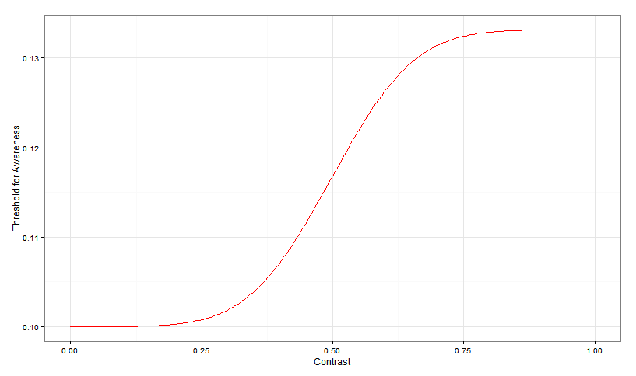
Expectations
Ped C

Slide 50
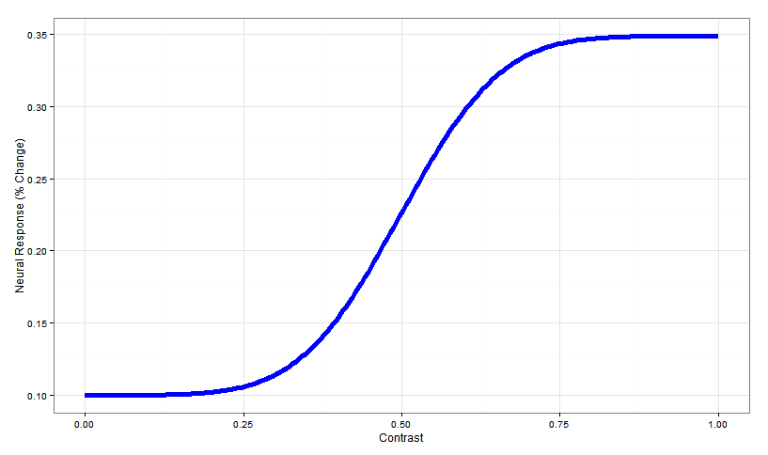
Expectations
Ped C

Slide 51
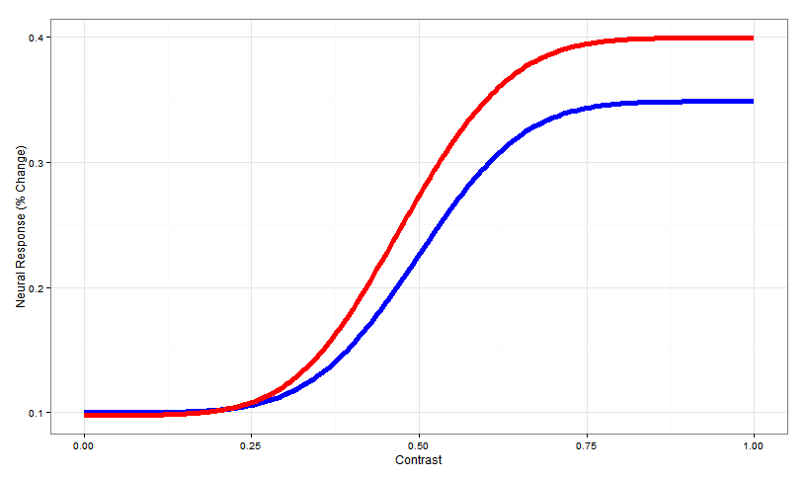
Expectations
Change in slope
due to attention
Ped C

Slide 52
Expectations
Can a (plausible) model of awareness, as a function of neural activity, capture the behavioral results in dual tasks?
Or do we need additional steps to explain how awareness can occur in the absence of “attention” (e.g. spatial attention) in some circumstances and not in others?
Change in slope
due to attention
Ped C

Slide 53
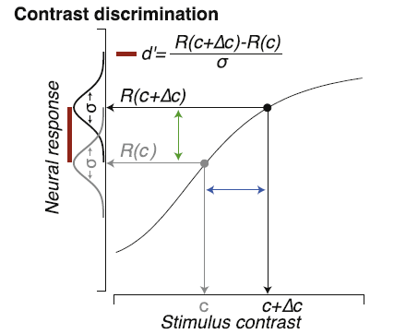
Identifying Neural Substrates
Pestilli et al., 2011

Slide 54
Identifying Neural Substrates
Pestilli et al., 2011
Notes:
Neural response is monotonic increasing according to some function R()

Slide 55
Identifying Neural Substrates
Pestilli et al., 2011

